Slide 1
COUNTY OF SACRAMENTO CANDIDATE FILING OVERVIEW
NOVEMBER 2022
GENERAL ELECTION

Slide 2
NOTICE TO CANDIDATES
This overview is intended to provide general information for candidates and committees, and does not have the force or effect of the law, regulation or rule. It is intended to help you understand your responsibilities and the information is subject to change.
It is distributed with the understanding that any prospective candidate obtain legal advice to assist in complying with applicable California Laws, including California Elections Code and California Government Code.

Slide 3
RESOURCES AVAILABLE ONLINE www.elections.saccounty.gov
CANDIDATE FILING APPOINTMENTS
ELECTION CALENDAR
OFFICES UP FOR ELECTION
CANDIDATE GUIDE
LETTER OF AUTHORIZATION
BALLOT DESIGNATION WORKSHEET
CODE OF FAIR CAMPAIGN PRACTICES
CANDIDATE STATEMENT WORKSHEET

Slide 4
IMPORTANT DATES
07/18 – 08/12 NOMINATION PERIOD (All original, signed documents must be received in our office by 5 p.m.)
08/02 LAST DAY TO CHANGE BALLOT DESIGNATION * Candidates may request a change in ballot designation that differs from the one used in the primary election; must be done in writing
08/12 LAST DAY TO WITHDRAW CANDIDACY *No candidate who has filed a Declaration of Candidacy for the General Election may withdraw as a candidate, after 5 p.m. on this date
08/13– 08/17 NOMINATION EXTENSION PERIOD * for offices in which the incumbent fails to file
09/12 – 10/25 WRITE IN PERIOD * Excludes runoff contests
*** FOR A DETAILED LOOK AT THE ELECTION CALENDAR PLEASE VISIT OUR WEBSITE : www.elections.saccounty.gov

Slide 5
CONTESTS ON BALLOT
Voter-nominated offices
Top two candidates from the Primary Election will runoff in the General Election
Local Offices
Schools and special districts – offices where more candidates file than the number of seats available
There are no filing fees for schools and special districts
County offices where no candidate obtained a majority vote in the Primary Election
City Offices
Contact the city clerk for more information
Filing fees – prospective candidates should contact the city clerk

Slide 6
REDISTRICTING
Every ten years districts are redrawn using U.S Census data. Redistricting is the process of drawing electoral district maps which, then, determine what neighborhoods and communities are grouped together. For most elected offices voters in each district elect representatives from those districts. Incumbents and candidates may be required to live in their district and, due to boundary line changes, may no longer reside in those districts.
POSSIBLE CHANGES TO HOW CANDIDATES ARE ELECTED
Due to transitioning some districts have changed to qualified and elected by district/area. Please refer to the Positions Up for Election on our website. www.elections.saccounty.gov
The new boundaries, for the districts that are up for election in the General Election, will not be available until after the certification of the June Primary Election.
Candidates or Incumbents who have questions regarding which districts they reside in may contact our office at (916) 875-6276.
The District Look up Tool is now available on our website at: https://pollingplacelookupen.saccounty.gov/VoterDistrictLookup

Slide 7
TOP TWO CONTESTS
All candidates for voter-nominated offices are listed on the primary ballot and only the top two candidates that receive the highest votes in the primary election – regardless of party preference - move on to the general election.
Candidates running for a voter-nominated office cannot run in the general election without having been one of the top two vote-getters in the primary election
TOP TWO CANDIDATES
Optional- If you are a candidate that is advancing from the Primary Election, you will have the option to submit a new candidate statement along with the estimated costs.
Make your check or money order payable to: County of Sacramento
Please review the Candidate Guide on our website for more information on filing a candidate statement as well as cost.

Slide 8
GETTING STARTED
What’s In Your Packet?

Slide 9
CANDIDATE FILING CHECKLIST
The following is a list of candidate nomination documents that may be included in your packet. Descriptions of each are found on the following pages.
Letter of Authorization (optional)
Candidate Receipt and Acknowledgment Form (required)
Nomination Petitions (required for some offices)
Ballot Designation Worksheet (optional)
Code of Fair Campaign Practices (optional)
Statement of Economic Interests – Form 700 (required)
Candidate Statement Coversheet (required)
Candidate Statement Form and Fee (optional)
Declaration of Candidacy (required)

Slide 10
LETTER OF AUTHORIZATION
A candidate may designate a specific person to obtain and/or file nomination papers and/or a Declaration of Candidacy form on behalf of the candidate.
A Letter of Authorization form can be found on our website and must be properly completed and signed prior to either obtaining or filing the nomination papers for a candidate.
The filed Letter of Authorization shall be retained by the elections official. (Elections Code § 8028)

Slide 11
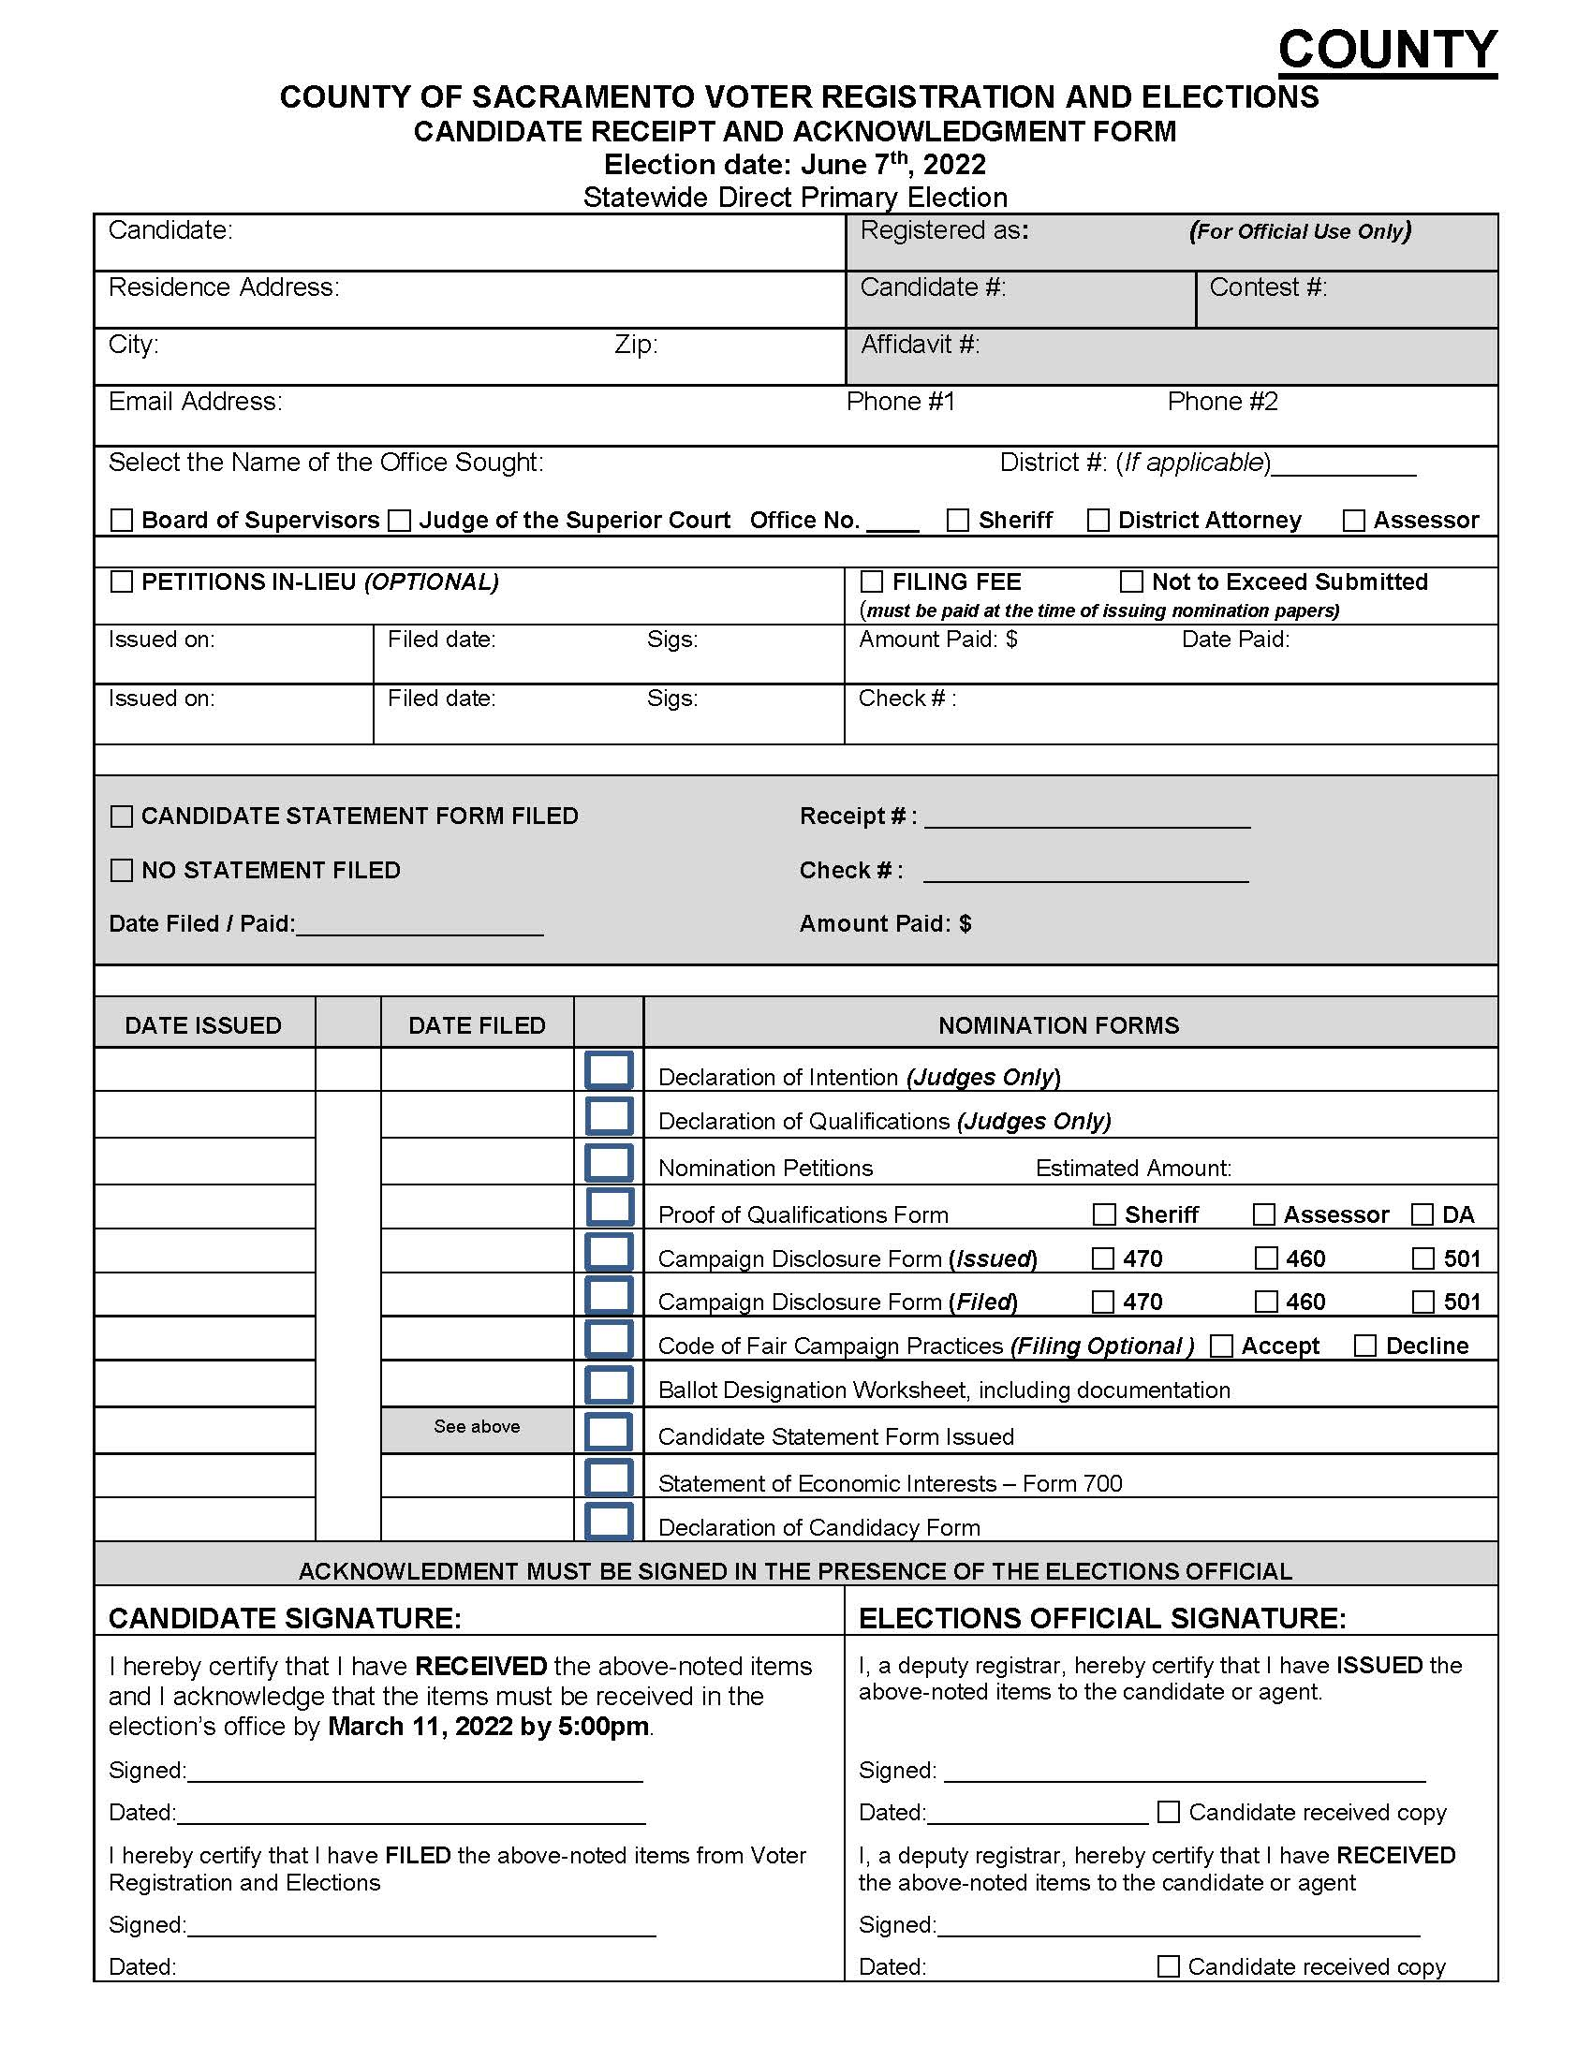
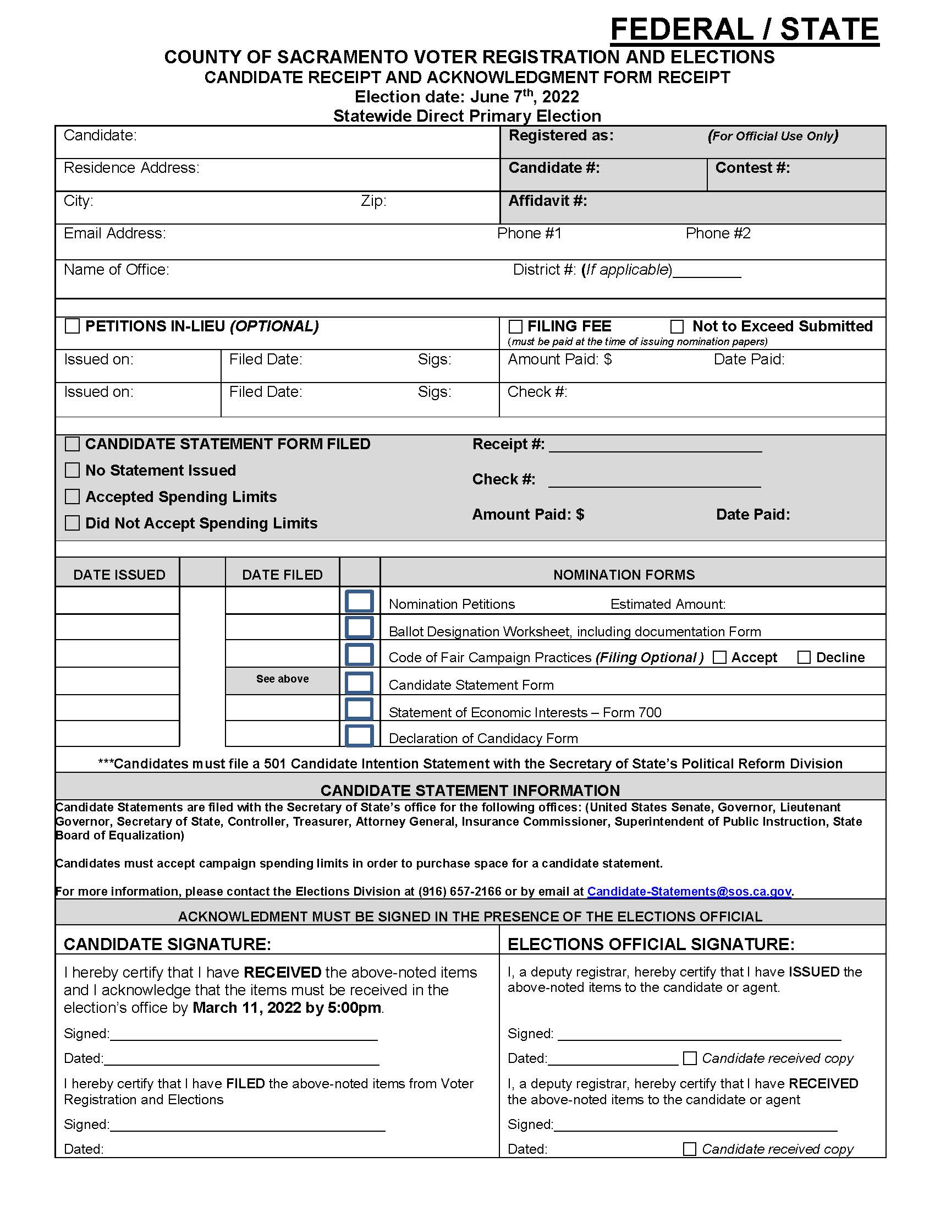
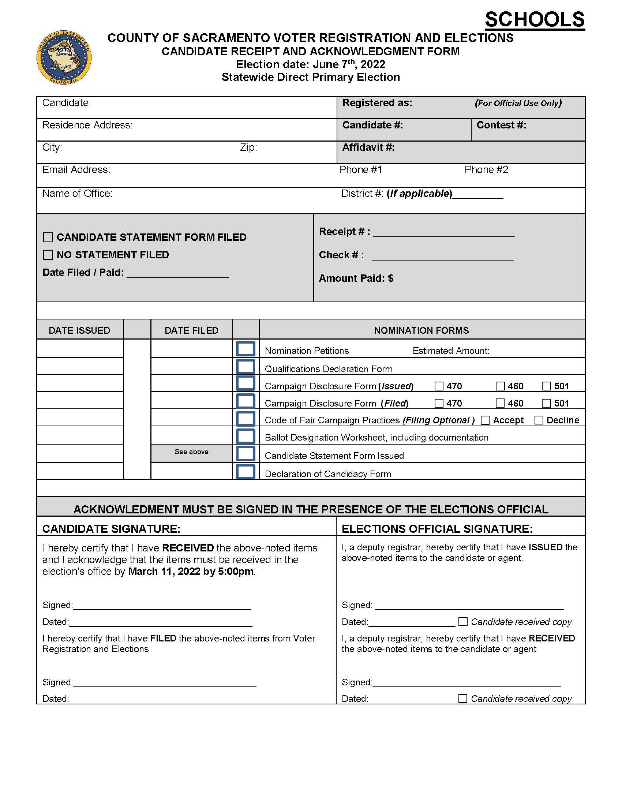
CANDIDATE RECEIPT AND ACKNOWLEDGMENT FORM
Completed by both the candidate and the elections official.
Serves as an acknowledgment of what was issued and received.
Must be signed in the presence of an elections official.
All candidates who are issued nomination papers will be required to acknowledge that all original, signed nomination documents are due in our office on August 12, 2022 by 5 pm.
It is your responsibility as a candidate to ensure that you have met the requirements and filed all nomination documents by the deadline.

Slide 12
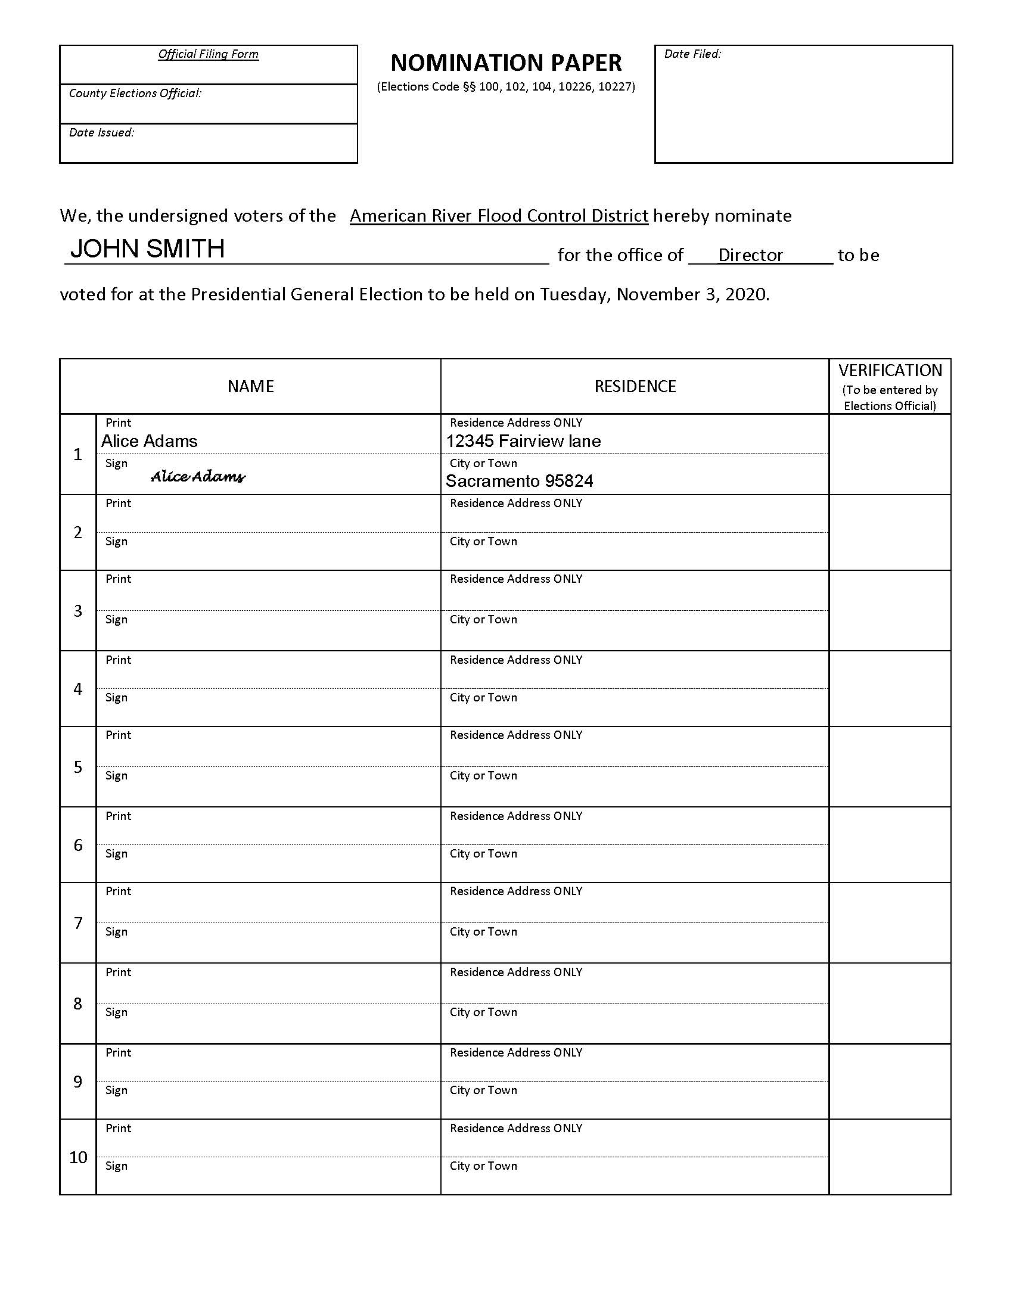
NOMINATION PETITIONS
The Following Offices Require Nomination Signatures:
American River Flood Control District
Florin RCD
SMUD- Sacramento Municipal Utility District
** City Offices- Contact City Clerk
Requirement for signers:
Signer must be a registered voter within the district, division or ward
Signer must print physical address only
Signer must print and sign their own name

Slide 13
NOMINATION PETITIONS AFFIDAVIT OF THE CIRCULATOR
INSTRUCTIONS
Candidates may circulate their own petitions.
Anyone that circulates a petition must be 18 years of age or older.
*Anyone that acts as a Circulator for a prospective candidate seeking election for SMUD Board of Directors must also be registered in the ward.
Circulator will print their name, address and dates that the petition was circulated.
Circulator’s signature is required.
Circulator must sign and date this
section of the Nomination Petition.
The bottom portion of the form is reserved for the Elections Official.

Slide 14
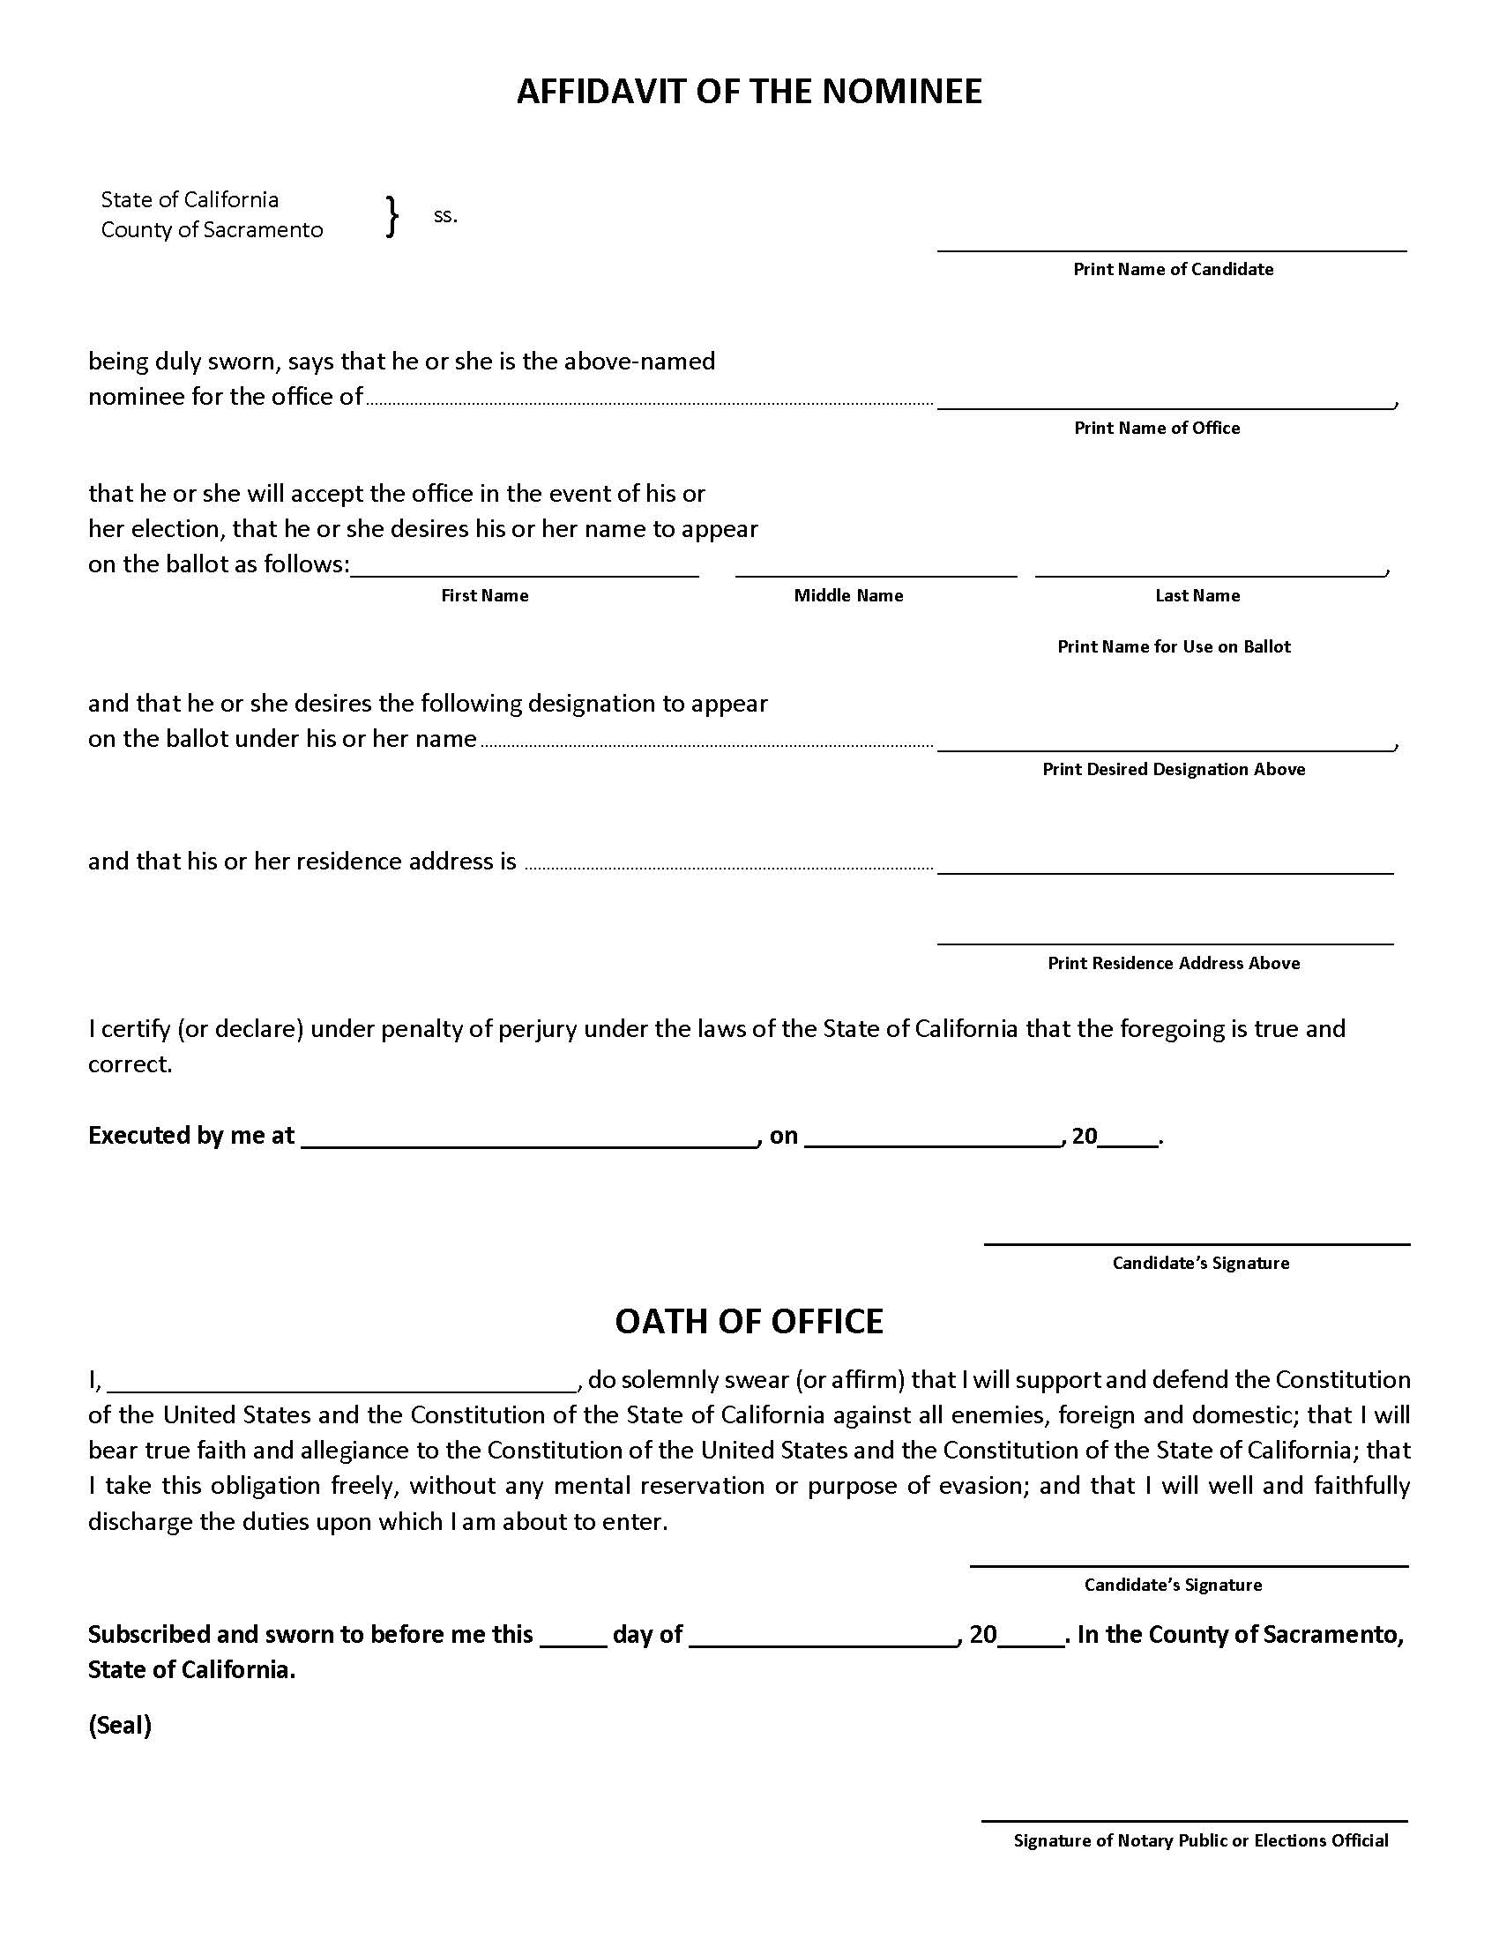
NOMINATION PETITIONS AFFIDAVIT OF THE NOMINEE
INSTRUCTIONS
Candidates must complete the Affidavit of the Nominee section.
This section contains the candidate’s name for use on the ballot, office sought, as well as the Ballot Designation proposed by the candidate.
Oath of Office must be administered by the Elections Official in the elections office and signed by both the candidate and the Elections Official.
If Oath of Office is administered by a Notary Public, then the candidate, and Notary will sign this section. Notary must then place their seal on the form.

Slide 15
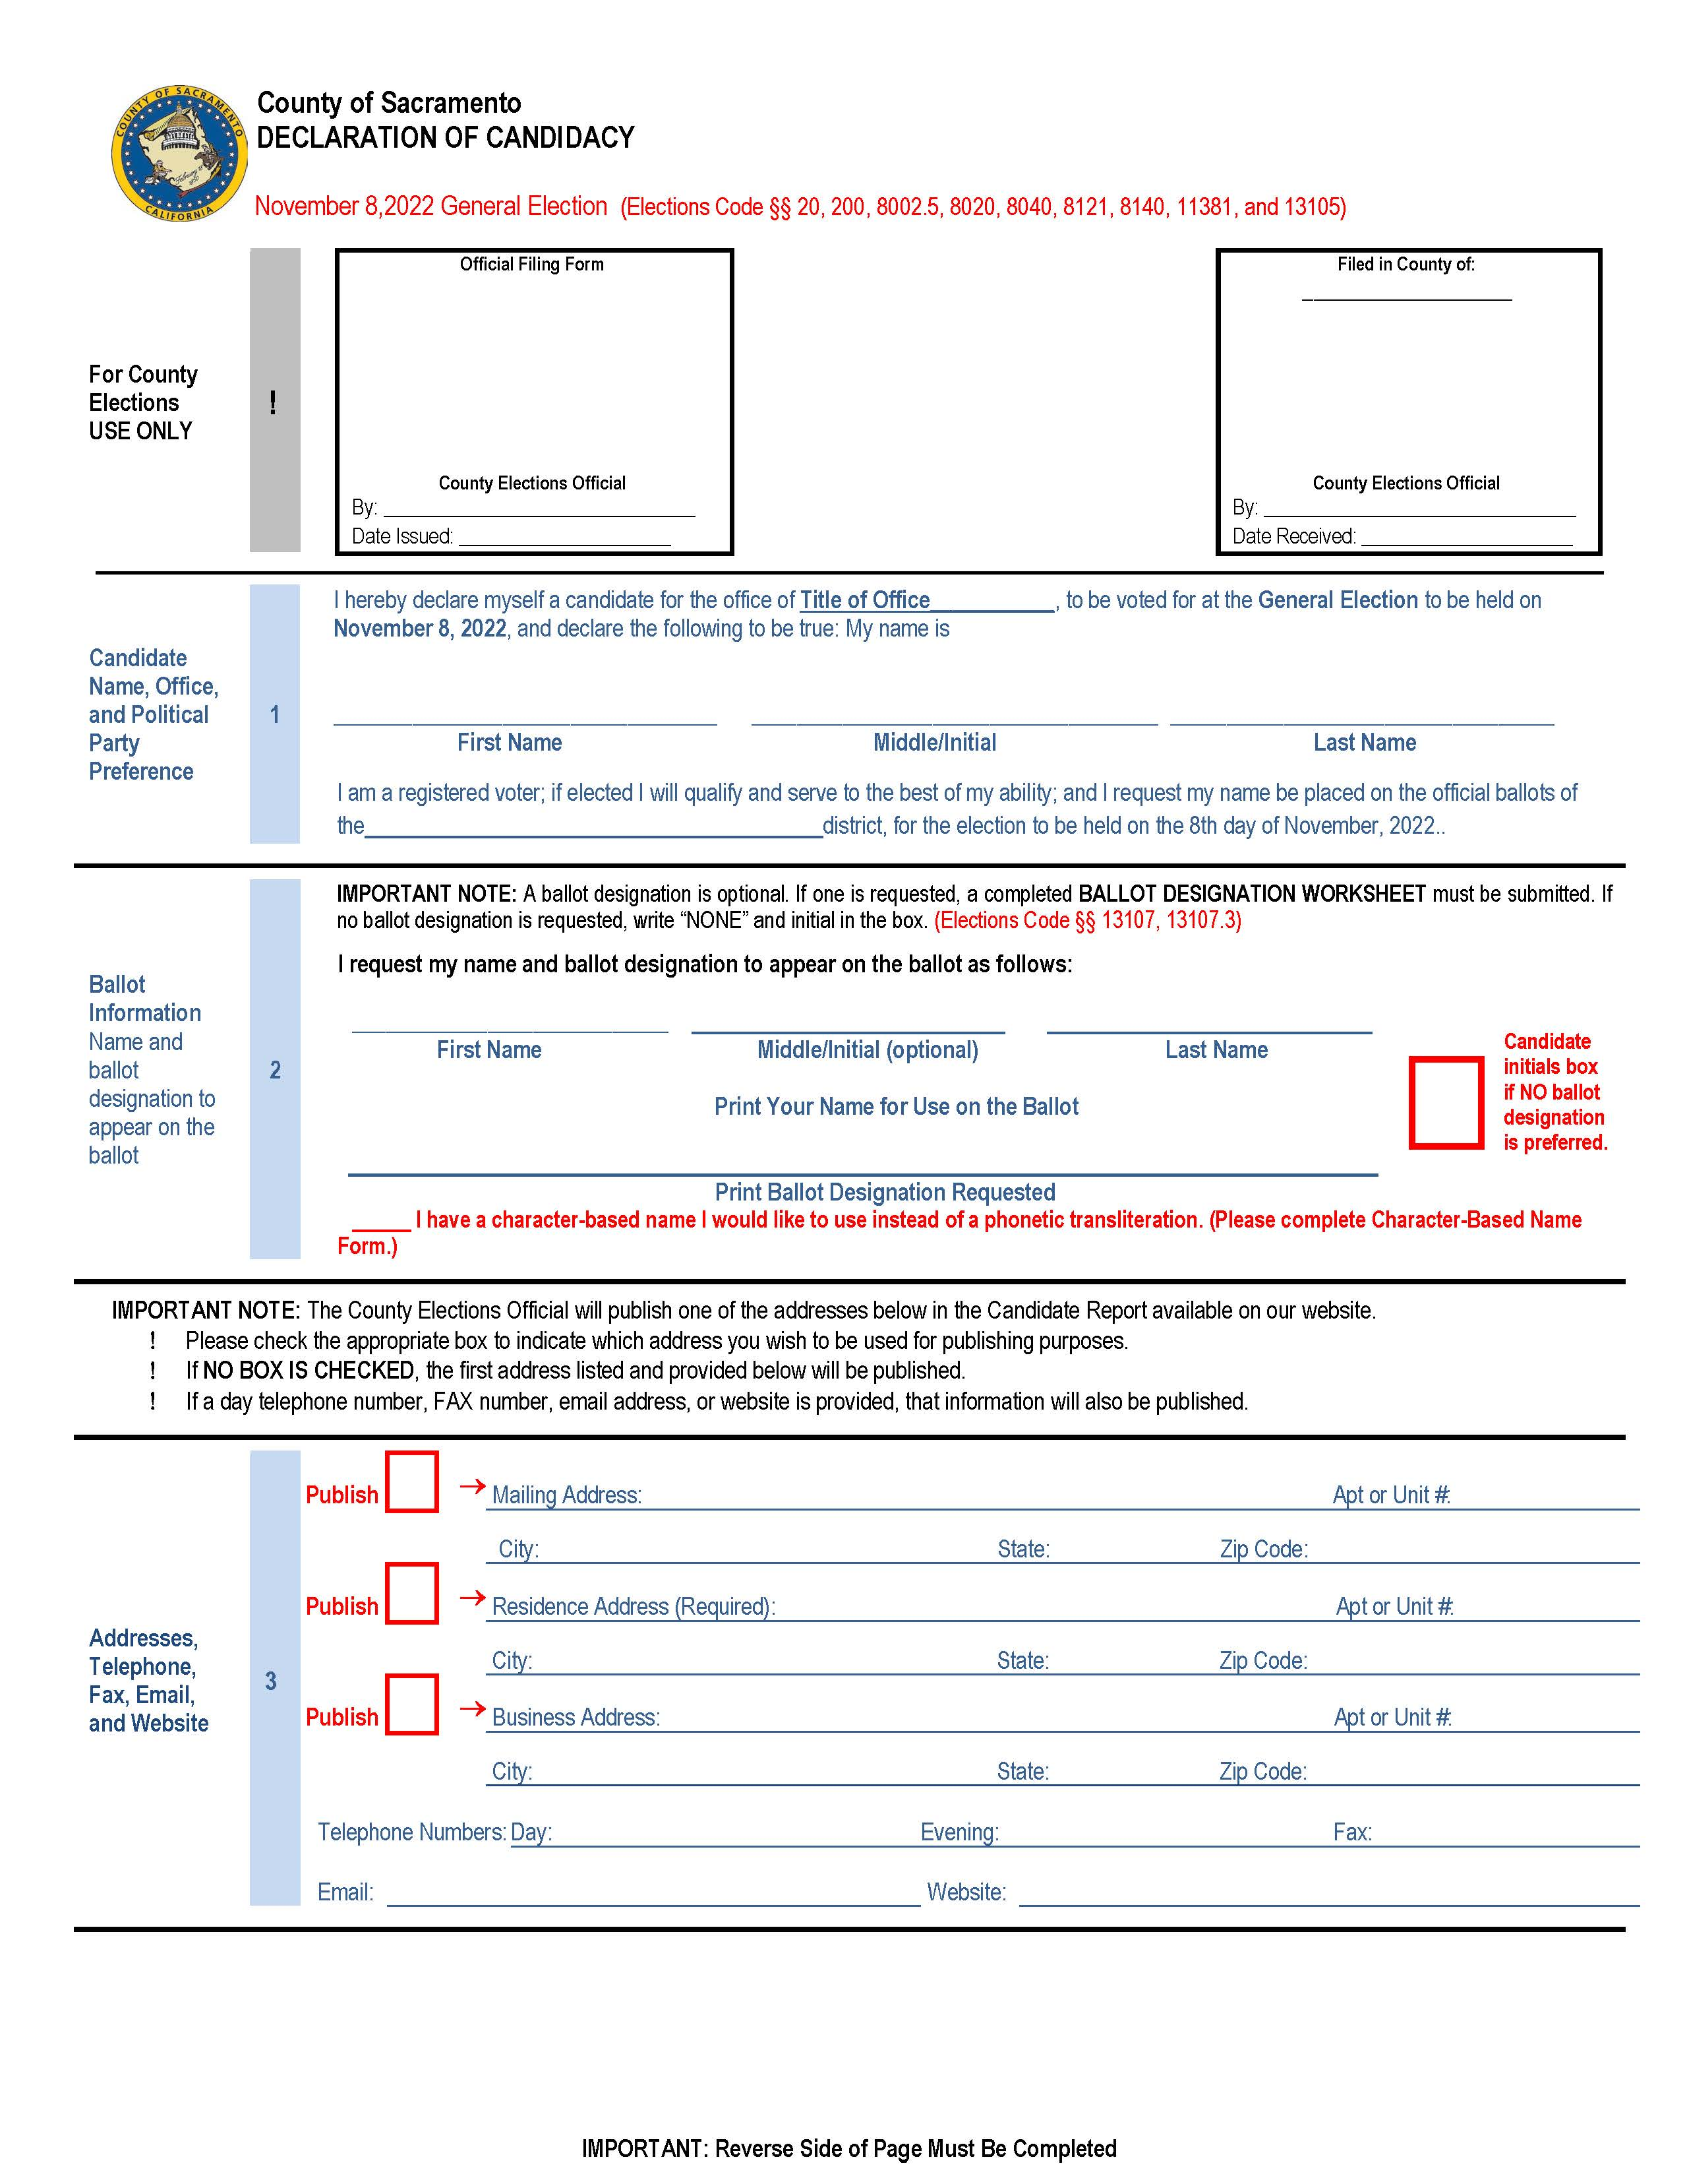
DECLARATION OF CANDIDACY - FRONT
^{INSTRUCTIONS}
^{Section 1:}
Candidate will print their name and office sought.
^{Section 2:}
Candidate will print their name for use on the ballot as well as the desired ballot designation.
A check box is provided for candidates that wish to provide a character-based name.
^{Section 3:}
The residence address field is required.
Note: This form will be made available only in our office unless requested by the candidate via mail or email.

Slide 16
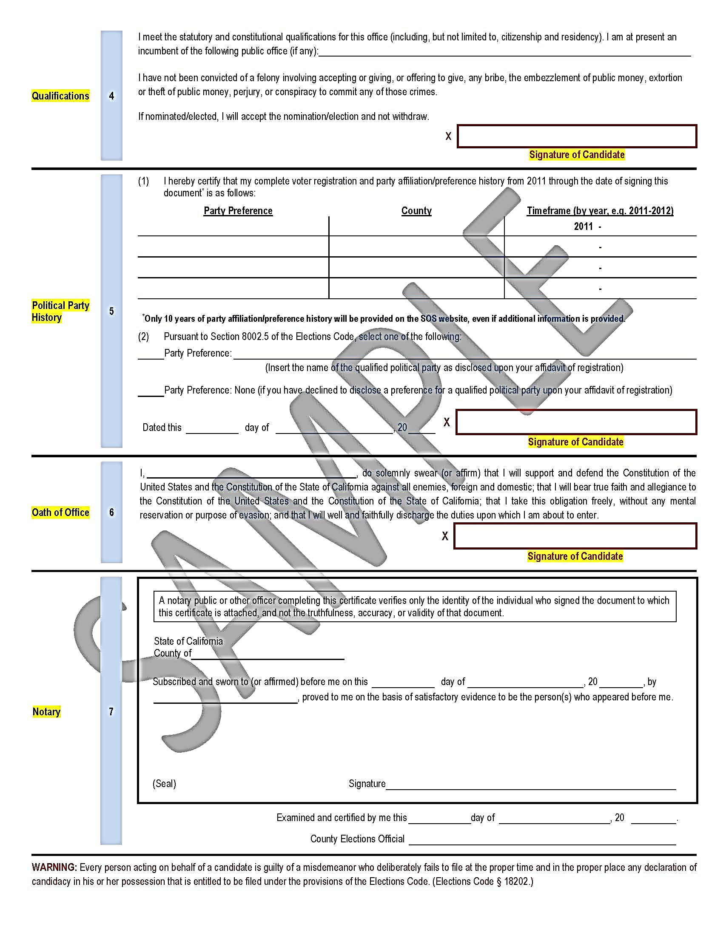
DECLARATION OF CANDIDACY - BACK
^{Section 4:}
If you are an incumbent, you must place the name of the office on this line.
All candidates are required to sign in the red box.
^{Section 5:}
The Oath of Office will be administered by the Elections Official in the Elections Office and signed by the candidate.
^{Section 6:}
This section must be completed by an Elections Official.
If the Oath of Office is administered by a Notary Public, the Notary will sign this section. Notary must then place their seal on the form.

Slide 17
BALLOT DESIGNATION WORKSHEET (Elections Code §§ 13107, 13107.3, 13107.5; California Code of Regulations § 20711)
WHAT IS IT?
The ballot designation is the word or group of words that will appear on the ballot under the candidate’s name designating the principal profession, vocation, or occupation of the candidate.

Slide 18
BALLOT DESIGNATION WORKSHEET (Elections Code §§ 13107, 13107.3, 13107.5; California Code of Regulations § 20711)
WHAT CAN I USE AS MY BALLOT DESIGNATION?
Elective Office: Words that designate the elective office which the candidate holds at the time of filing the nomination documents.
Incumbent: The word “incumbent” may be used if the candidate is a candidate for the same office that he or she holds at the time of filing the nomination papers.
3-word Profession/Vocation/Occupation: No more than three words designating either the current principal professions, vocations, or occupations of the candidate. If more than one profession, vocation or occupation is listed, it shall be separated by a slash (“/”).
Appointed Incumbent: The phrase “Appointed Incumbent” may be used if the candidate holds an office by virtue of appointment, and the candidate is running for the same office.

Slide 19
BALLOT DESIGNATION WORKSHEET (Elections Code §§ 13107, 13107.3, 13107.5; California Code of Regulations § 20711)
DO NOT LEAVE ANY RESPONSES BLANK
If the information requested does not pertain, please mark the response as N/A.
Complete the gender option which will be used for translation purposes only.
The ballot designation is limited to three words and must be your current profession, vocation, or occupation and should be added to the first line of the Proposed Ballot Designation section.
If you are an Incumbent, you may use your official district designation which will be counted as one word.
Acceptable Ballot Designations Include:
Teacher ( must have credentials)
Plumber
Homemaker
Registered Nurse
Security Officer
Incumbent
Unacceptable:
Concerned Citizen
Taxpayer
Philanthropist
Neighborhood Advocate

Slide 20
BALLOT DESIGNATION WORKSHEET (Elections Code §§ 13107, 13107.3, 13107.5; California Code of Regulations § 20711)
The justification for the use of the Proposed Ballot Designation from the prior page corresponds with page 2.
WHAT’S A JUSTIFICATION?
A justification is additional information about why you are proposing the use of the ballot designation. This includes a brief description of your duties as well as the name of your employer, business and a contact who can verify the information is correct and may include a family member.
Note: Comments such as “I work here” or “I’ve been doing this for 20 years” are unacceptable.
Make sure that you complete the questions on this page and initial.
THIS PAGE MUST BE SIGNED AND DATED.

Slide 21
BALLOT DESIGNATION WORKSHEET (Elections Code §§ 13107, 13107.3, 13107.5; California Code of Regulations § 20711)
A. If you decided to add an Alternate Ballot Designation from line 2 of the first page use section A for the justification.
B. If you decide to add an additional Alternate Ballot Designation from line 3 of the first page, use section B for the justification.
Attention !!!
If you are not adding any Alternate Ballot Designations, then you are only required to initial the form at the very top.

Slide 22
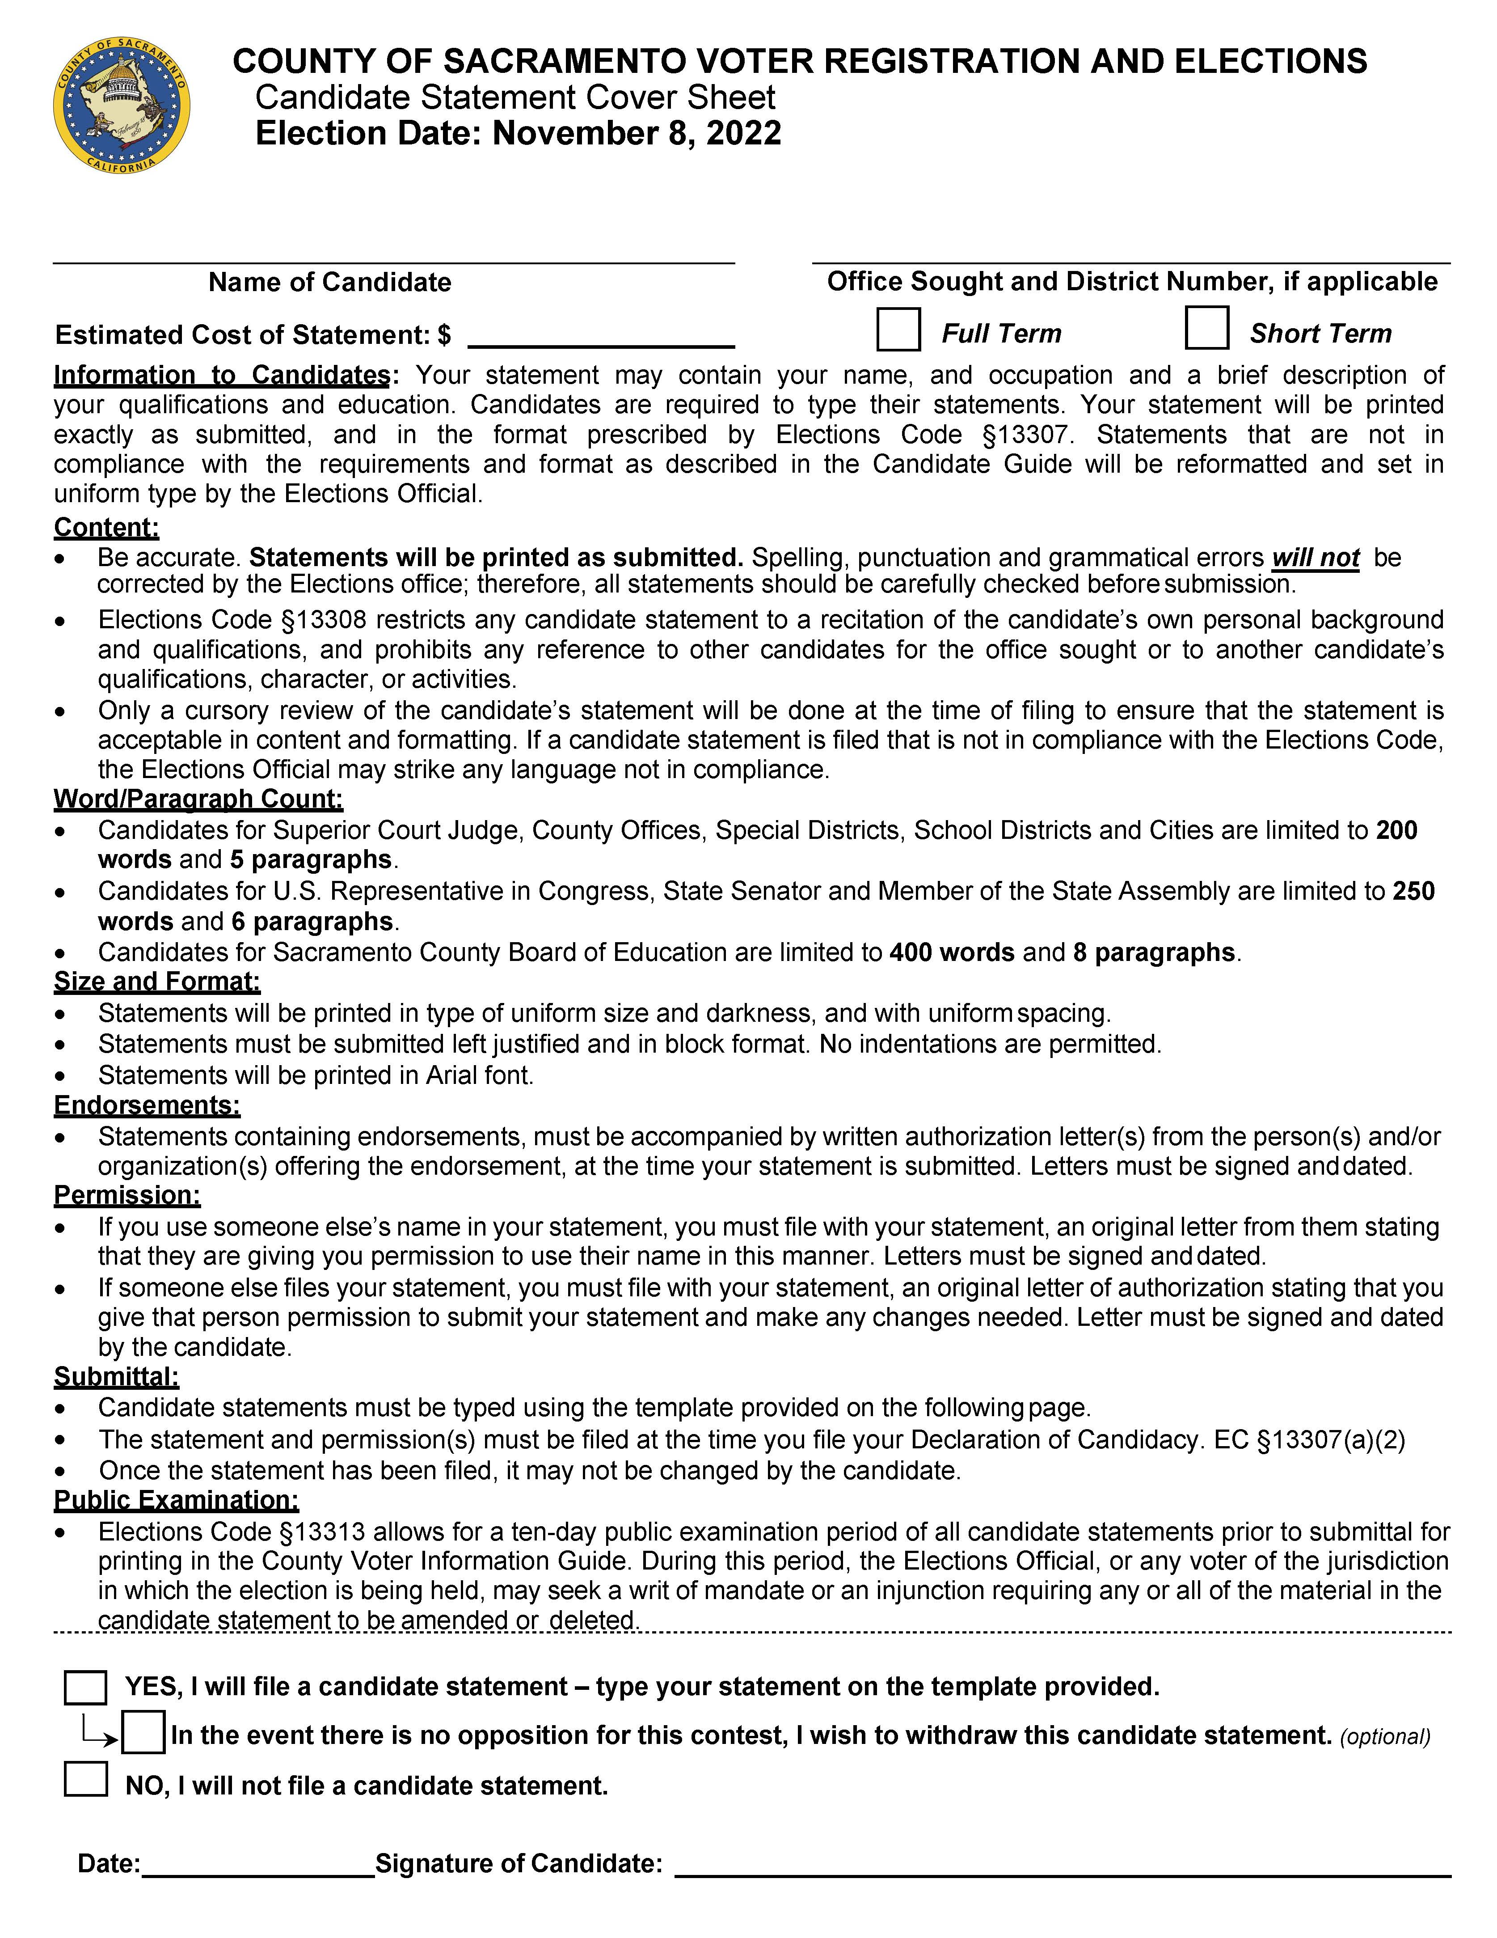
CANDIDATE STATEMENT FORM
What is it?
A statement that is limited to your own personal background and qualifications.
All candidates must complete the coversheet.
The statement must be type written.
We recommend using the Candidate Statement fillable form available on our website.
The statement must meet the word count requirement.
Review your candidate statement for spelling and grammar before filing. Once submitted, it cannot be changed.
NOTE:
You are required to complete the Candidate Statement Cover Sheet even if you are not planning on filing a candidate statement for the County Voter Information Guide.
There is a section above the date and signature line that indicates no statement will be filed.

Slide 23
CANDIDATE STATEMENT FORM
DO NOT USE
Bullets, stars or asterisks
Bolding
Italics
Underlining
All capital letters (with the exception of acronyms or abbreviations)
Tables
Lists or other formatting requiring indentation

Slide 24
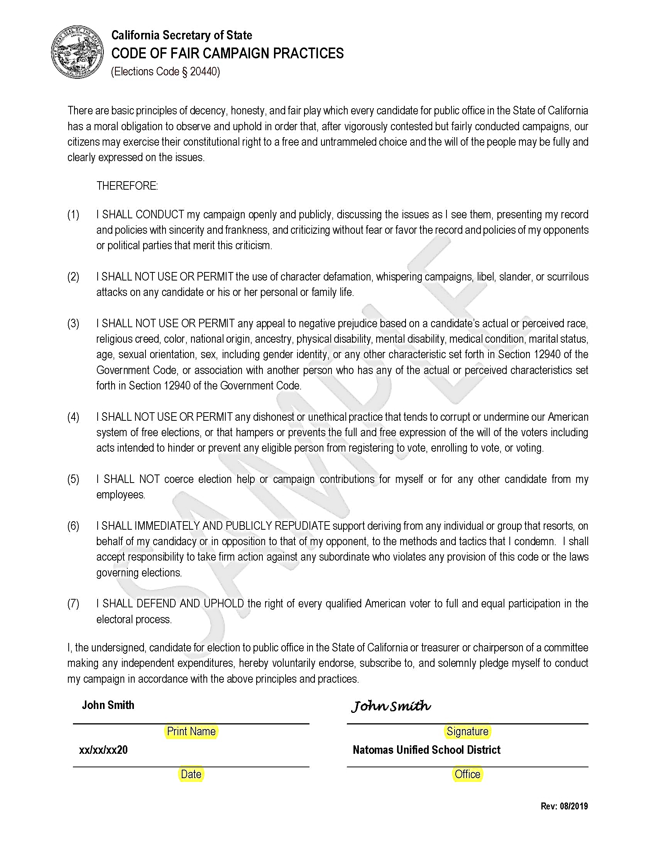
CODE OF FAIR CAMPAIGN PRACTICES
INSTRUCTIONS
This is an optional form and states that you plan to run a fair campaign.
California legislation has passed recommendations on how candidates should run a fair campaign.
Should you choose to complete the form please sign and date the bottom.

Slide 25
FPPC CAMPAIGN FORMS
Form 501 – All candidates must file a 501 form before soliciting or accepting contributions
Form 470 – Candidates who don’t plan on spending $2000 or more on their campaign will complete a 470 form
Form 700 – All candidates running for local elective offices are required to complete a 700 Form

Slide 26
WHAT FORM SHOULD I FILE?
For more information please visit: https://www.fppc.ca.gov/content/dam/fppc/NS-Documents/TAD/Candidate%20Toolkit/Campaign-Basics-01-18.pdf

Slide 27
FORM 501
***ALL CANDIDATES MUST COMPLETE AN FPPC 501 FORM
INSTRUCTIONS
Select a box at the top of the form indicating if this is an initial filing or an amendment to a form already received.
Section1:
Add name, address, contact information and office sought including the year the election will take place.
Section 2:
Do not enter any information on Section 2 unless you are a state candidate.
Section 3:
Sign and date the form.

Slide 28
FORM 470 ***CANDIDATES WHO HAVE A CANDIDATE CONTROLLED COMMITTEE DO NOT NEED TO COMPLETE AN FPPC 470 FORM
INSTRUCTIONS
Complete the top of the form with date of the election.
Section 1:
Add the current election year.
Section 2:
Print name, address, and any additional contact information.
Section 3:
Enter title of the office sought or held. Then enter the name of the district in the jurisdiction field.
Section 4:
Leave this section blank unless you wish to report a candidate-controlled committee.
Section 5:
Sign and date the form.

Slide 29
FORM 700
INSTRUCTIONS
Start with first and last name then complete Section 1 with the name of the district as the agency and title of the office sought as the position.
Section 2: Jurisdiction of Office: Check the box associated with “County” and add Sacramento.
Section 3: Type of Statement:
Check the box for Candidate and enter the date of the election.
Section 4: If you have no schedules attached enter 1 for the total number of pages included. If schedules apply, please check the appropriate box and attach schedules.
Section 5: Complete this section and make sure to sign and date.
NOTE: If you are an incumbent re-running for the same office and you just recently filed your 700 – you are still obligated to file a Form 700 for your November 8, 2022 candidacy.
Incumbents may provide a new cover sheet. Check the box for candidate and enter the date of the election. Attach copies of the schedules, if applicable.

Slide 30
ADDITIONAL QUESTIONS REGARDING FPPC
Review the applicable Campaign Disclosure Manual
Candidates and committee treasurers can find the forms in this packet and additional forms on the FPPC website: www.fppc.ca.gov
Email: advice@fppc.ca.gov
Phone: 866-ASK-FPPC (1-866-275-3772)
Telephone advice is available:
Monday through Thursday 9:00 a.m. - 11:30 a.m.

Slide 31
WRITE-IN CANDIDATES
A write-in candidate will only move on to the general election if the candidate is one of the top two vote-getters in the primary election.
Notwithstanding any other provision of law, a person may not be a write-in candidate at the general election for a voter-nominated office. Elections Code § 8606
Candidates that wish to run as write-ins must complete a Statement of Write-in Candidacy Form.
Signers of nomination petitions for write-in candidates shall be voters in the district or political subdivision in which the candidate is to be voted on.
No fee shall be required of a write-in candidate.
Write-in candidates may not file a candidate statement.

Slide 32
SERVICES AVAILABLE
Voter Files
Walking Lists
Voting Activity Status Report (formerly the vote by mail subscription)
Precinct Lists
Maps
For fee information and to obtain an application for voter data please visit our website at: www.elections.saccounty.gov
Voter registration information may be provided to candidates running for office, a ballot measure committee and person or groups for elections, scholarly, journalistic, political or governmental purposes as determined by the Secretary of State. (Title 2, division 7, article 1, § 19003 of the California code of regulations, and elections code § 2194 and government code § 6254.4)

Slide 33
QUESTIONS?
Contact the Campaign Services Division:
Sacramento County Voter Registration & Elections
Campaign Services Division
7000 65th Street, Suite A
Sacramento, CA 95823
Phone (916) 875-6276
Fax (916) 854-9567
Email: voters-campaignservices@saccounty.gov
City candidates, please contact your city clerk for more information and requirements.

