Slide 1

County of Sacramento
Voter Registration and Elections
Guide to Voter Registration

Slide 2
This presentation has been prepared as a reference to help individuals, groups and volunteers participating in voter registration activities. It is important that anyone seeking to register individuals to vote know the regulations and laws regarding voter registration.
We encourage citizen involvement in the electoral and registration processes.
Additional information or clarification is available by calling the Voter Registration and Elections Office at (916) 875-6451. Office hours are Monday through Friday, 8:00 a.m. through 5:00 p.m., excluding holidays.

Slide 3
How to Get Started
Visit the Elections Office
  7000 65th Street, Suite A, Sacramento, CA 95823
There is no charge for voter registration forms
If an individual or organization wishes to obtain 50 or more voter registration forms, they must complete the Voter Registration Card Statement of Distribution form. This form is provided by the Elections Office and requires the name, address, telephone number and organization of the person requesting the forms as well as a brief explanation of how the forms are to be distributed
If 2,000 or more voter registration forms are requested, a copy of the Voter Registration Card Statement of Distribution form is forwarded to the Secretary of State, Elections Division

Slide 4
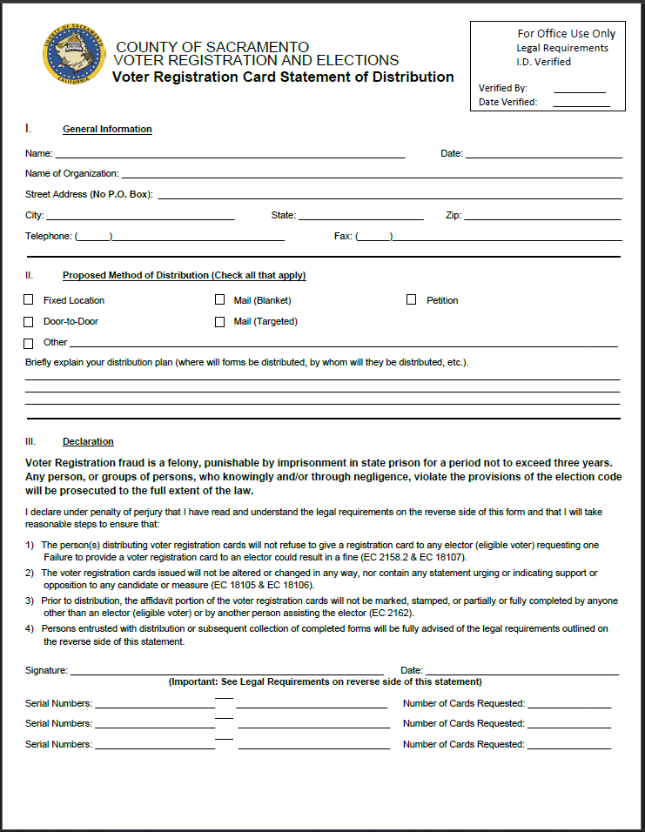
Voter Registration Card Statement of Distribution
This form must be filled out by anyone obtaining 50 or more registration forms
Fill out the following information
General Information:
Name
Date
Name of Organization
Street Address, State, Zip Code
Telephone Number
Proposed Method of Distribution:
Choose at least one method of distribution
Provide a brief explanation of the distribution plan
Declaration:
Must be read and acknowledged
PowerPoint Presentation must be dated with the date it was viewed
Signature:
Person obtaining registration forms must sign
Serial Numbers:
Will be filled out by the Elections Office
Legal Requirements:
The Person obtaining registration cards must comply with the Legal Requirements

Slide 5
Legal Requirements
County of Sacramento Voter Registration and Elections Guide
The Registrar of Voters requires that each person distributing voter registration cards receives the County of Sacramento Voter Registration and Elections Guide.
The following requirements must be complied with by all persons and/or organizations to which registration cards are issued. Non- compliance may result in referral to the appropriate law enforcement agency.
Receipt – A person who assumes responsibility for returning another person’s completed registration card to the elections official, must complete the green box section of the Voter Registration Card by signing, dating, and listing their name, address and telephone number on the card itself and on the receipt portion of the card (Elections Code § 2158).
Return of Affidavits – Persons distributing voter registration cards must return all completed affidavits in their possession within three working days, excluding Saturdays, Sundays, and state holidays. Retaining completed affidavits for more than three days, or denying the voter’s right to return his or her completed affidavit is a misdemeanor. All blank cards must be returned to the elections official immediately after the 15th day preceding a statewide primary or general election, and whenever instructed to do so by the elections official. (Elections Code §§ 2138, 2139, 18103.)
Unsolicited Mailing – Any mailing of a registration card to a person who did not request one must be accompanied by a cover letter or other notice with each card, instructing the recipient to disregard they are currently registered to vote. (Elections Code § 2158)
Failure or Refusal to Return Affidavit of Registration – An individual or organization having charge of affidavits of registration is guilty of a misdemeanor who knowingly neglects or refuses to return affidavits of registration as provided in Article 3 (commencing with Section 2138) of Chapter 2 of Division 2. The county elections official shall report to the district attorney of the county, under oath, the names of all individuals or organizations who have failed to return the affidavits. The district attorney shall take appropriate civil or criminal action. (Elections Code § 18104)
Confidential Information – Notwithstanding any other provision of law, an affiant’s driver’s license number, identification card number, and social security number, contained on a affidavit of registration or voter registration card, are confidential and shall not be disclosed by an individual or organization that distributes voter registration cards or by any person entrusted with an affidavit of registration from an elector. However, this section shall not be construed to prohibit a person entrusted with an affidavit of registration from an elector from returning that affidavit to the person or organization that distributed the voter registration card, as specified by law. (Elections Code § 2138.5)
False Registration – Any deputy elections official or registration elections official who knowingly registers a nonexistent person, knowingly registers a person under a false name or address, or knowingly registers a person who is ineligible to register is punishable by imprisonment in the state prison or county jail. (Elections Code § 18102)
Misrepresentation – Any person who receives money or non-monetary compensation for assisting another to register to vote, is guilty of a misdemeanor if they knowingly misrepresent himself or herself when helping register another to vote on a registration form and receive the completed affidavit of registration from the voter. (Elections Code § 18108.1)
Note: Organizations receiving completed cards for delivery to the Elections official must ensure that all cards completed in whole or in part by prospective registrants are promptly forwarded to the elections official. This includes cards containing irregularities or minimal information, i.e. a name and address.
The Elections officials, not the organization distributing or receiving cards, will determine the validity of the registration.

Slide 6
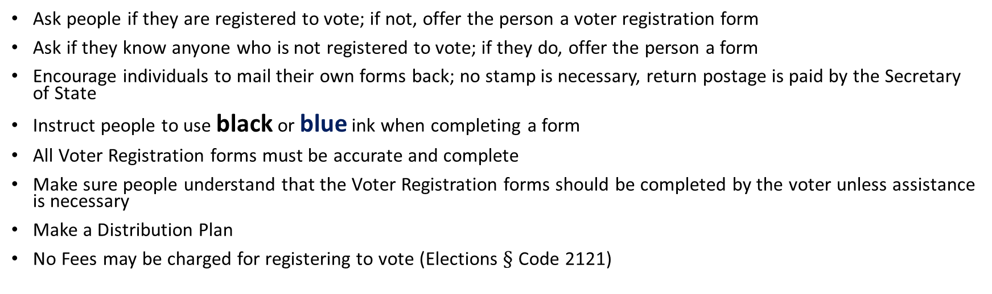
Important Things to Remember When Distributing Registration Forms
Ask people if they are registered to vote; if not, offer the person a voter registration form
Ask if they know anyone who is not registered to vote; if they do, offer the person a form
Encourage individuals to mail their own forms back; no stamp is necessary, return postage is paid by the Secretary of State
Instruct people to use black or blue ink when completing a form
All Voter Registration forms must be accurate and complete
Make sure people understand that the Voter Registration forms should be completed by the voter unless assistance is necessary
Make a Distribution Plan
No Fees may be charged for registering to vote (Elections $§$ Code 2121)
Direct any questions regarding voter registration or elections to the
Sacramento County Elections Office
Telephone Number: (916) 875-6451
Email: voterinfo@saccounty.gov

Slide 7
Important Things Not To Do When Distributing Registration Forms
Do not use a pencil
Do not refuse to give a registration form to anyone who asks for one. You must accept a completed form from anyone regardless of their party preference or address. Forms where an individual lists a residential address outside of Sacramento County will be forwarded to the appropriate county.
Do not highlight or make any marks on the registration form
Do not attempt to answer questions, except to explain how to complete the Voter Registration form
Do not give Voter Registration forms to other people or organizations who have not been authorized to distribute forms by the Elections Office (Remember you are solely responsible for the registration forms that are assigned to you)

Slide 8
Who is Eligible to Register to Vote?
Anyone who is:
  A citizen of the United States
  A resident of California. 16 years old may pre-register, they must be 18 years old on or before Election Day to vote in an Election
  Not serving a state or federal prison term for the conviction of a felony
  Not deemed by an appropriate court to be mentally incompetent
Elections Code $§§$: 2000, 2101, 2211

Slide 9
When should a person fill out a Voter Registration Form?
If a person meets the eligibility requirements and if they—
  Have never registered to vote in Sacramento County
  Have moved
  Have changed their name
  Wish to change their political party preference
  Wish to update their signature on their voter registration

Slide 10
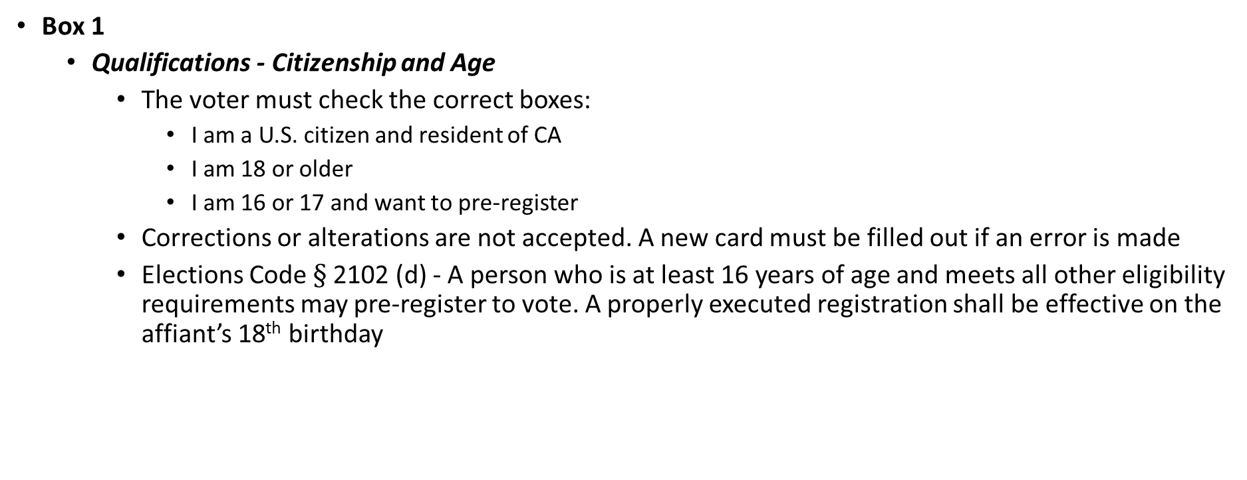
Step by Step Instructions on How to Complete a Voter Registration Form
Box 1
  Qualifications - Citizenship and Age
    The voter must check the correct boxes:
      I am a U.S. citizen and resident of CA
      I am 18 or older
      I am 16 or 17 and want to pre-register
    Corrections or alterations are not accepted. A new card must be filled out if an error is made
    Elections Code $§$2102 (d) - A person who is at least 16 years of age and meets all other eligibility requirements may pre-register to vote. A properly executed registration shall be effective on the affiant’s 18th birthday

Slide 11
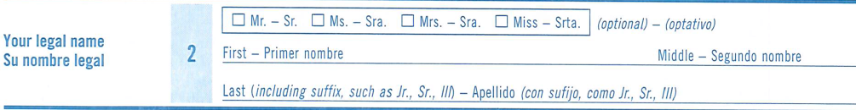
Step by Step Instructions on How to Complete a Voter Registration Form
Box 2
  Name
    Have the voter clearly print their name

Slide 12
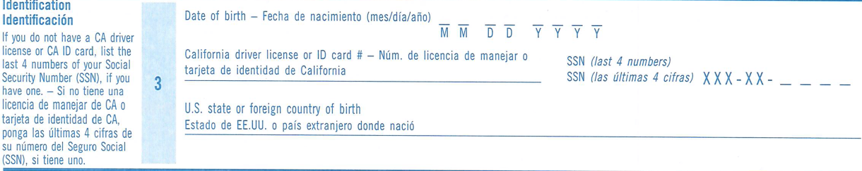
Step by Step Instructions on How to Complete a Voter Registration Form
Box 3
  Date of Birth, Identification Requirements, and Place of Birth
    Date of birth is required
    CA Driver’s License OR
    CA Identification Card OR
    If the voter does not have either, they may provide the last four digits of their Social Security number
    If the voter does not have any of the three ID requirements listed above, the registration form will still be accepted
    The U.S. State or foreign country of birth

Slide 13
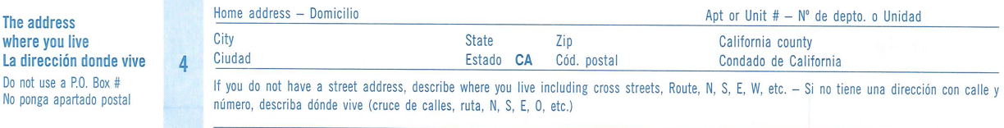
Step by Step Instructions on How to Complete a Voter Registration Form
Box 4
  Home Address
    Voter must fill in their complete address and city where he/she resides
    A Post Office Box or business address is not accepted as a home address
  If the voter does not have a residence address
    The voter must give an exact description of where they sleep at night. Include cross streets, street corners and basic directions (N,S,E,W), bridges, routes or other landmarks

Slide 14
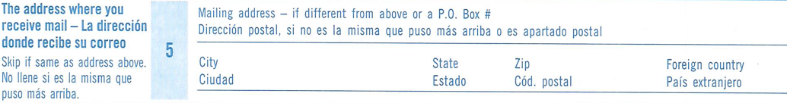
Step by Step Instructions on How to Complete a Voter Registration Form
Box 5
  Mailing Address
    Voter must fill out the mailing address field if they wish to receive their election material at an address other than their home address

Slide 15
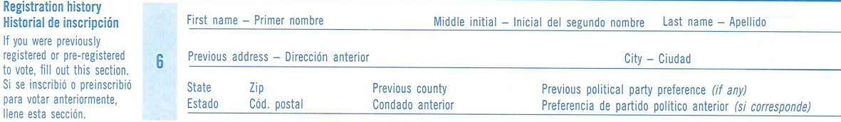
Step by Step Instructions on How to Complete a Voter Registration Form
Box 6
  Prior Registration
    Should be completed if the voter has been previously registered in a different state. If the voter does not remember the complete address, have them write as much information as possible.
    Not necessary for voters previously registered in a different California county.

Slide 16
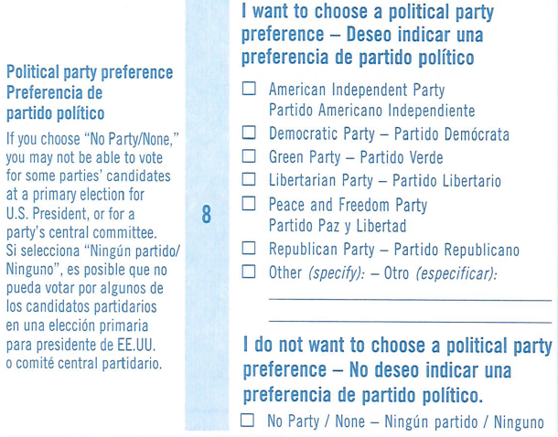
Step by Step Instructions on How to Complete a Voter Registration Form
Box 8
  Political Party Preference
    The voter may choose to be affiliated with a political party or may choose No Party Preference
    If a political party preference is left blank, the voter will be registered as Unknown, and shall otherwise be treated as a No Party Preference voter
    Only one political party preference can be marked
    Corrections or alterations are not accepted. A new card must be filled out if an error is made

Slide 17
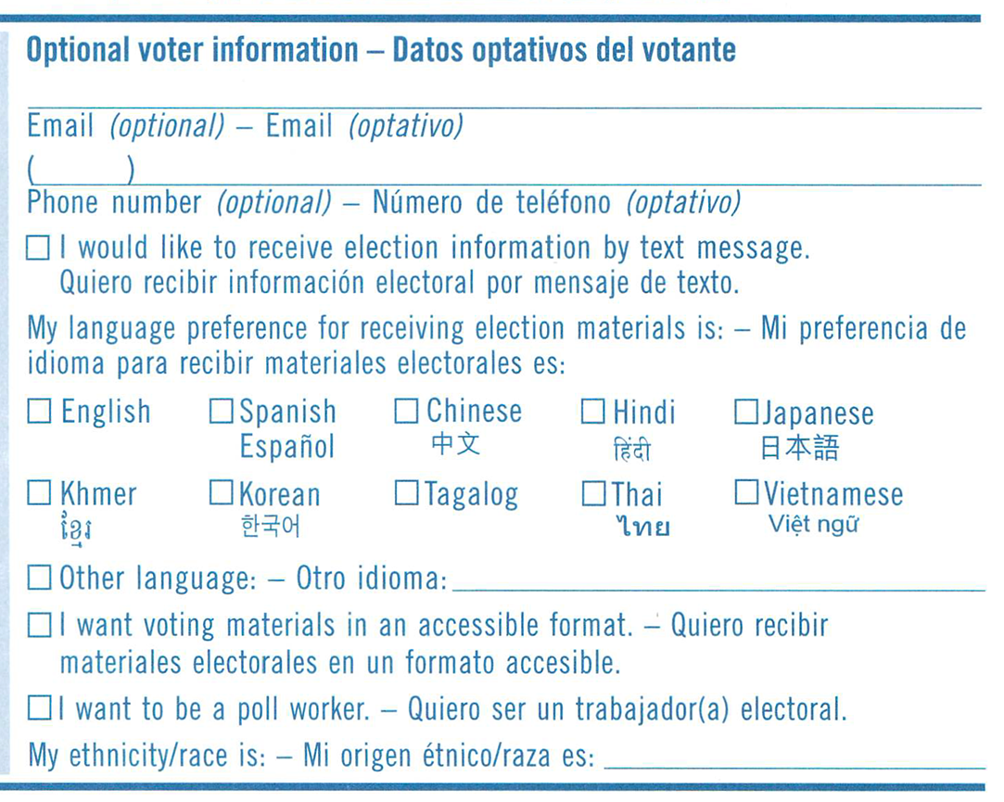
Step by Step Instructions on How to Complete a Voter Registration Form
Box 9 (Optional)
  The voter may complete this section if:
    They want to provide their email and/or phone number
    They want to receive election material in another language
    They want to receive election materials in an accessible format
    If they’re interested in working in a county Vote Center
    They want to provide their ethnicity/race

Slide 18
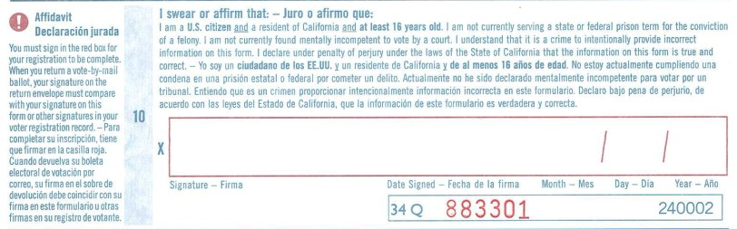
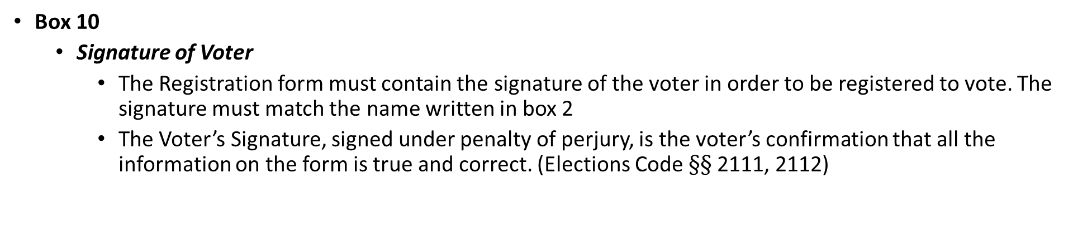
Step by Step Instructions on How to Complete a Voter Registration Form
Box 10
  Signature of Voter
    The Registration form must contain the signature of the voter in order to be registered to vote. The signature must match the name written in box 2
    The Voter’s Signature, signed under penalty of perjury, is the voter’s confirmation that all the information on the form is true and correct. (Elections Code $§§$2111, 2112)

Slide 19
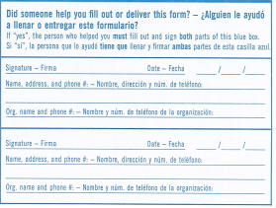
Step by Step Instructions on How to Complete a Voter Registration Form
The Bottom Portion of the Registration Form
  If someone helped the voter physically fill out the form, the person who helped must fill out and sign both parts of the box

Slide 20
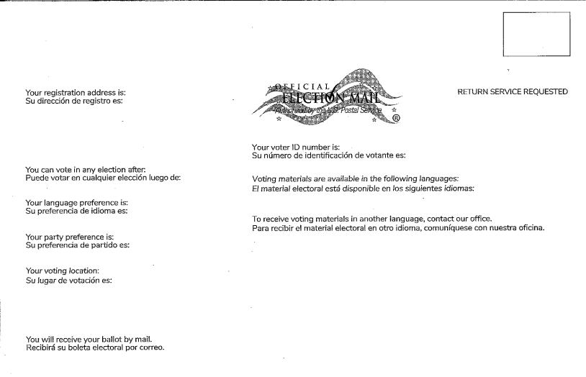
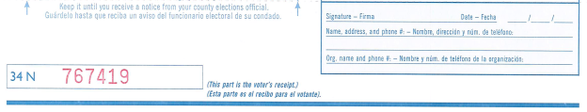
Step by Step Instructions on How to Complete a Voter Registration Form
The Bottom Portion of the Registration Form (Receipt)
  At the bottom of the form, fill out and tear off the receipt at the perforation and give it to the voter
The voter will be sent a postcard, like the one below, confirming their registration within 2- 4 weeks. If they don’t receive the postcard, they can contact our office.

Slide 21
Once the Registration Form(s) are Completed
Forms must be delivered to the County Elections Office or the Secretary of State’s Office, or deposited in the postal service within 3 days of receiving the completed forms or by the 15th day prior to an election, whichever comes first
Mailed forms must be postmarked on or before the 15th day prior to an election to be eligible to vote in that election
You are ultimately responsible for the forms that were issued to you

Slide 22
California Elections Code
Specific codes covering crimes include -
  2159 – Person/Organization who is paid to assist with voter registration must disclose full name, telephone number and address on each affidavit form
  2159.5 – Report requirements for person/organizations that pay others for assisting persons to register to vote
  18100 – Registration of persons not entitled to register. Consists of nonexistent persons including but not limited to, deceased person, animals and inanimate objects
  18101 – Registration of fictitious person
  18102 – Registration of nonexistent person
  18103 – Interference with transfer of affidavit to county elections official
  18104 – Refusal to return affidavits of registration
  18105 – Writing or affixing political statements on affidavits of registration
  18106 – Alteration of affidavit party affiliation
  18107 – Fine for failure to provide voter registration card

Slide 23
Prepared by:
County of Sacramento
Voter Registration and Elections
7000 65th Street, Suite A
Sacramento, CA 95823
Phone: (916) 875-6451
Fax: (916) 875-6516
Email: voterinfo@saccounty.gov
Web Site: www.elections.saccounty.gov
Speech and Hearing Impaired
California Relay Service: Dial 711

